Slide 1
CALL NUMBER
PP
567.33
Am5231
1960
Section
DDC Number
Author’s Number
Publication Date

Slide 2
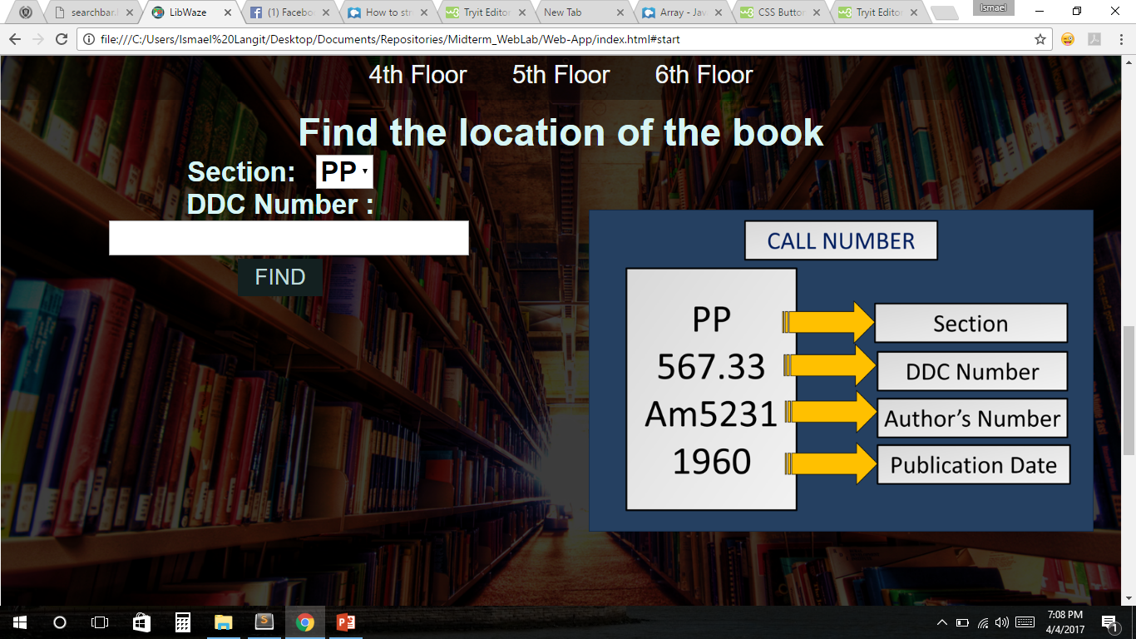

Slide 3
